Slide 1
World Wide Web and HTTP
TCP/IP Protocol Suite
Copyright © The McGraw-Hill Companies, Inc. Permission required for reproduction or display.

Slide 2
22-1 ARCHITECTURE
The WWW today is a distributed client-server service, in which a client using a browser can access a service using a server.
Service provided is distributed over many locations called sites.
Each site holds one or more documents, referred to as Web pages.
Each Web page, can contain some links to other Web pages in the same or other sites.
TCP/IP Protocol Suite

Slide 3
22-1 ARCHITECTURE
The World Wide Web (WWW) is a system of interlinked web pages and multimedia content that you can access over the Internet using a web browser.
The Internet is the network of computers and cables.
The Web is one of the services that runs on the Internet (like email or file sharing).
TCP/IP Protocol Suite

Slide 4
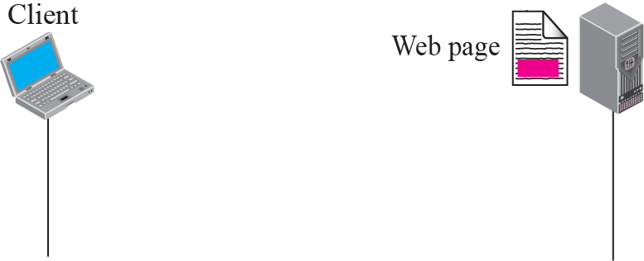
Figure 22.1 Example 22.1
Retrieve a Web page that contains the biography of a famous character with some pictures, which are embedded in the page itself.
Since pictures are not stored as separate files, the whole document is a simple Web page.
It can be retrieved using one single request/ response transaction.
TCP/IP Protocol Suite

Slide 5
Example 22.2
Retrieve a document that contains one reference to another text file and one reference to a large image.
Main document and the image are stored in 2 separate files in the same site (file A and file B); the referenced text file is stored in another site (file C).
We need three transactions if we want to see the whole document.
TCP/IP Protocol Suite

Slide 6
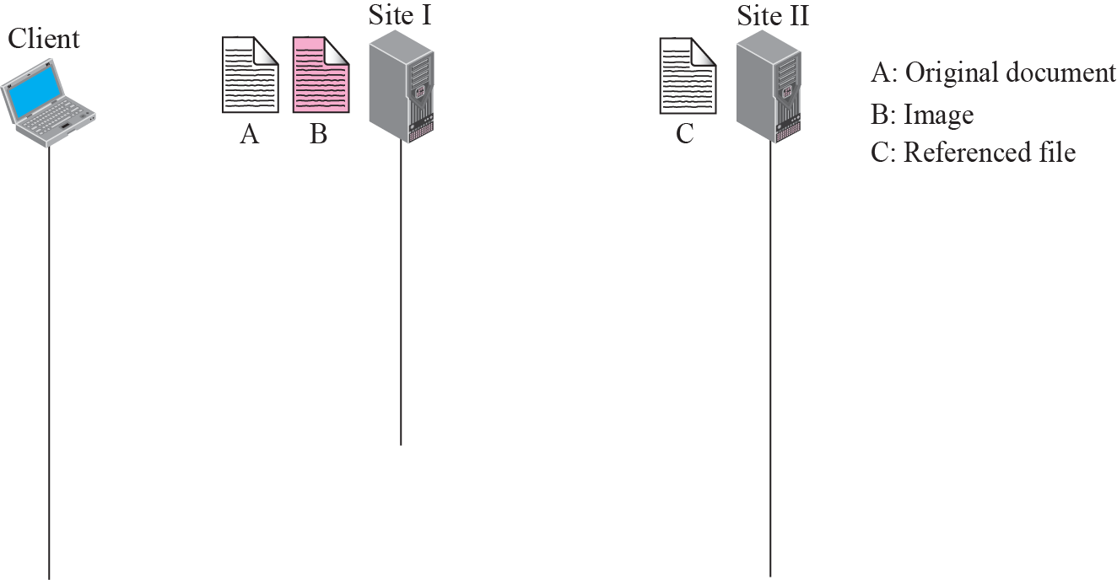




Figure 22.2 Example 22.2
TCP/IP Protocol Suite

Slide 7
Example 22.3
File A, file B, and file C are independent Web pages, each with independent names and addresses.
We can also retrieve each file independently.
TCP/IP Protocol Suite

Slide 8
Hypertext and Hypermedia
Hypertext :
In a hypertext document, a part of text can be defined as a link to another document.
When a hypertext is viewed with a browser, the link can be clicked to retrieve the other document.
Hypermedia : term applied to document that contains links to other textual document or documents containing graphics, video, or audio.
TCP/IP Protocol Suite

Slide 9
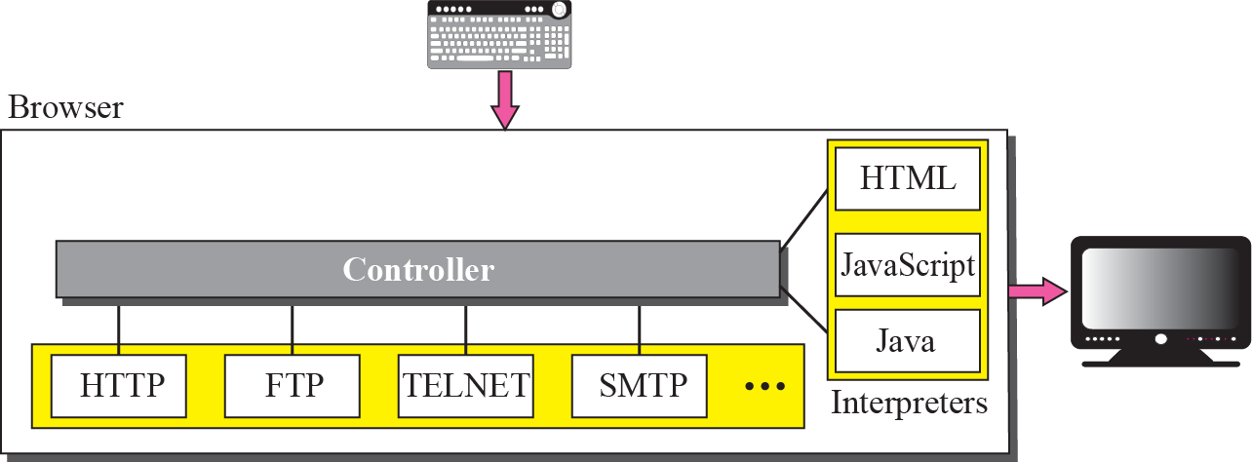
Figure 22.3 Browser
Web Client (Browser)
browsers that interpret and display a Web document.
Each browser usually consists of 3 parts:
  a controller,
  client protocol, and
  interpreters.
TCP/IP Protocol Suite

Slide 10
Figure 22.3 Browser
Web Client (Browser)
Controller receives input from the keyboard ( or mouse ) and uses the client programs to access the document.
After the document has been accessed, the controller uses one of the interpreters to display the document on the screen.
The client protocol can be FTP, or TELNET, or HTTP.
Interpreter can be HTML, Java, or JavaScript, depending on the type of document.
TCP/IP Protocol Suite

Slide 11
Figure 22.3 Browser
Web Server
The Web page is stored at the server.
Each time a client request arrives, the corresponding document is sent to the client.
To improve efficiency, servers normally store requested files in a cache in memory; memory is faster to access than disk.
A server can also become more efficient through multithreading.
Example: Apache and Microsoft Internet Information Server.
TCP/IP Protocol Suite

Slide 12
Uniform Resource Locator (URL)
A client that wants to access a Web page needs the file name and the address.
The uniform resource locator (URL) is a standard locator for specifying any kind of information on the Internet.
The URL defines four things: protocol, host computer, port, and path.
TCP/IP Protocol Suite

Slide 13
Uniform Resource Locator (URL)
Protocol : client-server application program used to retrieve the document.
Example: FTP, HTTP.
host : domain name of the computer on which the information is located.
usually begin with the characters “www”.
The URL can optionally contain the port number of the server.
Path : is the pathname of the file where the information is located.
TCP/IP Protocol Suite

Slide 14
22-2 WEB DOCUMENTS
The documents in the WWW can be grouped into three broad categories: static, dynamic, and active.
Category is based on the time the contents of the document are determined.
TCP/IP Protocol Suite

Slide 15
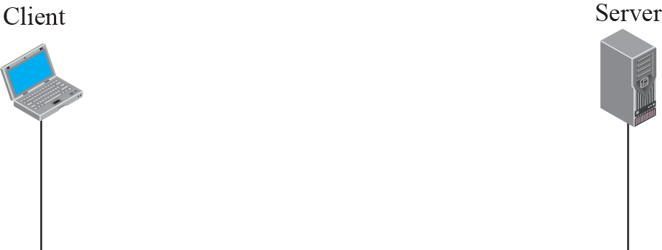
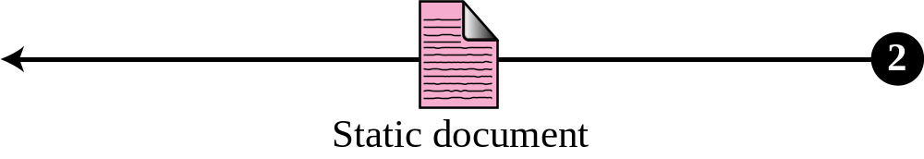
Figure 22.5 Static document
Static Documents
Static documents are fixed-content documents that are created and stored in a server.
TCP/IP Protocol Suite

Slide 16
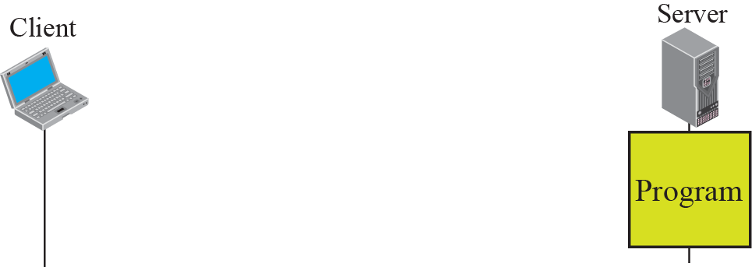
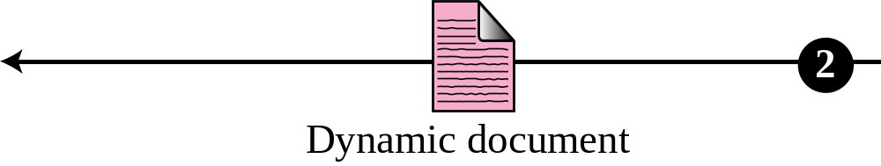
Figure 22.6 Dynamic document using CGI
Dynamic Documents
A dynamic document is created by a Web server whenever a browser requests the document.
TCP/IP Protocol Suite

Slide 17
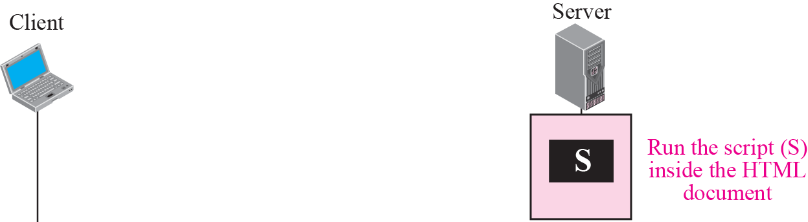
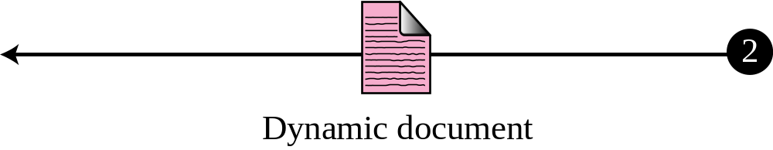
Figure 22.7 Dynamic document using server-site script
TCP/IP Protocol Suite

Slide 18
Figure 22.8 Active document using Java applet
Active Documents
For many applications, we need a program or a script to be run at the client site.
These are called active documents.
For example, suppose we want to run a program that creates animated graphics on the screen or a program that interacts with the user.
The program definitely needs to be run at the client site where the animation or interaction takes place.
When a browser requests an active document, the server sends a copy of the document or a script.
The document is then run at the client (browser) site.
TCP/IP Protocol Suite

Slide 19
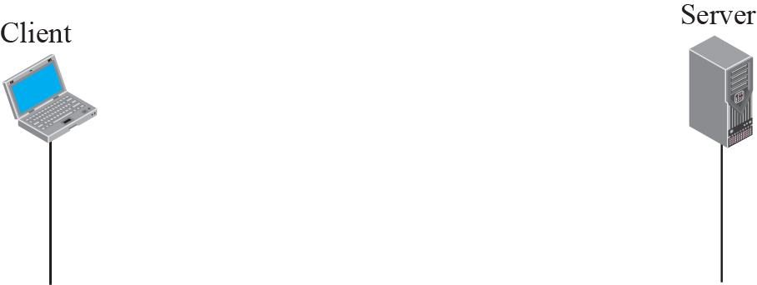
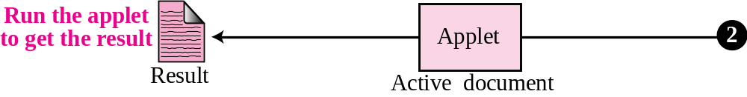
Figure 22.8 Active document using Java applet
Active Documents
TCP/IP Protocol Suite

Slide 20
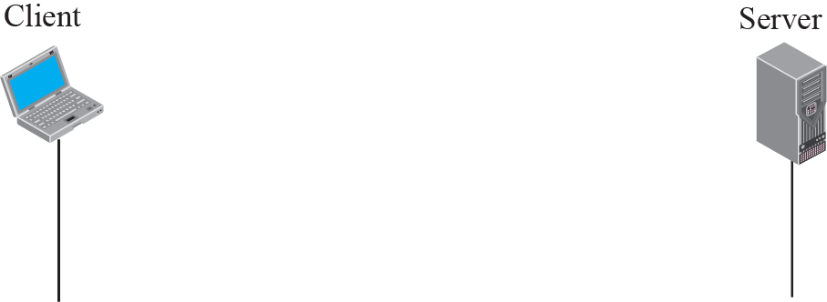
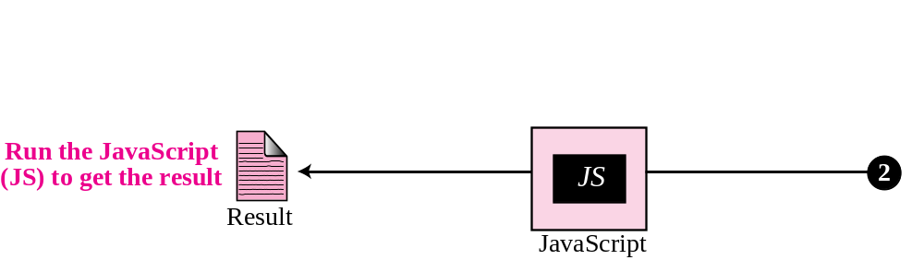
Figure 22.9 Active document using client-site script
Active Documents
TCP/IP Protocol Suite

Slide 21
22-3 HTTP
Protocol used mainly to access data on the World Wide Web.
HTTP uses the services of TCP on well known port 80.
TCP/IP Protocol Suite

Slide 22
HTTP uses the services of TCP on well-known port 80.
TCP/IP Protocol Suite

Slide 23
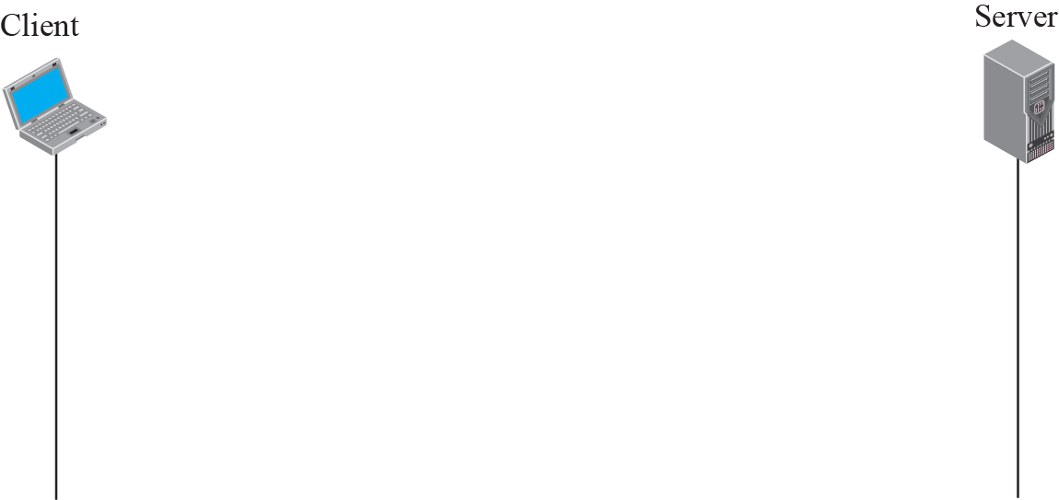
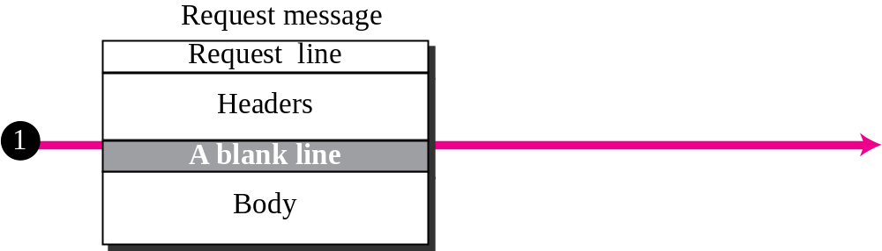
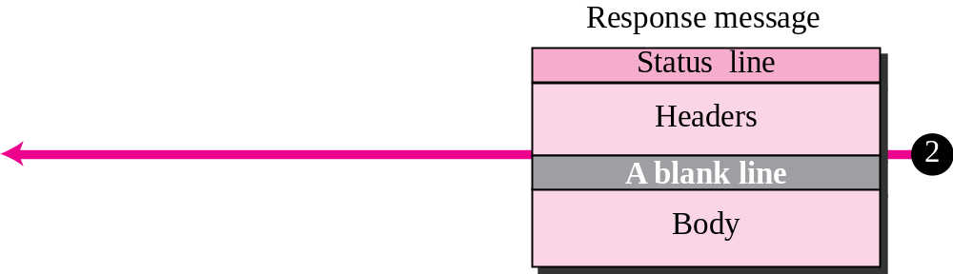
Figure 22.10 HTTP transaction
TCP/IP Protocol Suite

Slide 24

Figure 22.10 HTTP transaction
Request message consists of a request line, a header, and sometimes a body.
Request Line
Contains 3 fields: method, URL and version
These 3 fields separated by a space character.
At the end, a carriage return followed by a line feed terminate the line.
The method field defines the request type.
In version 1.1 of HTTP, several methods (Table 22.1)
TCP/IP Protocol Suite

Slide 25
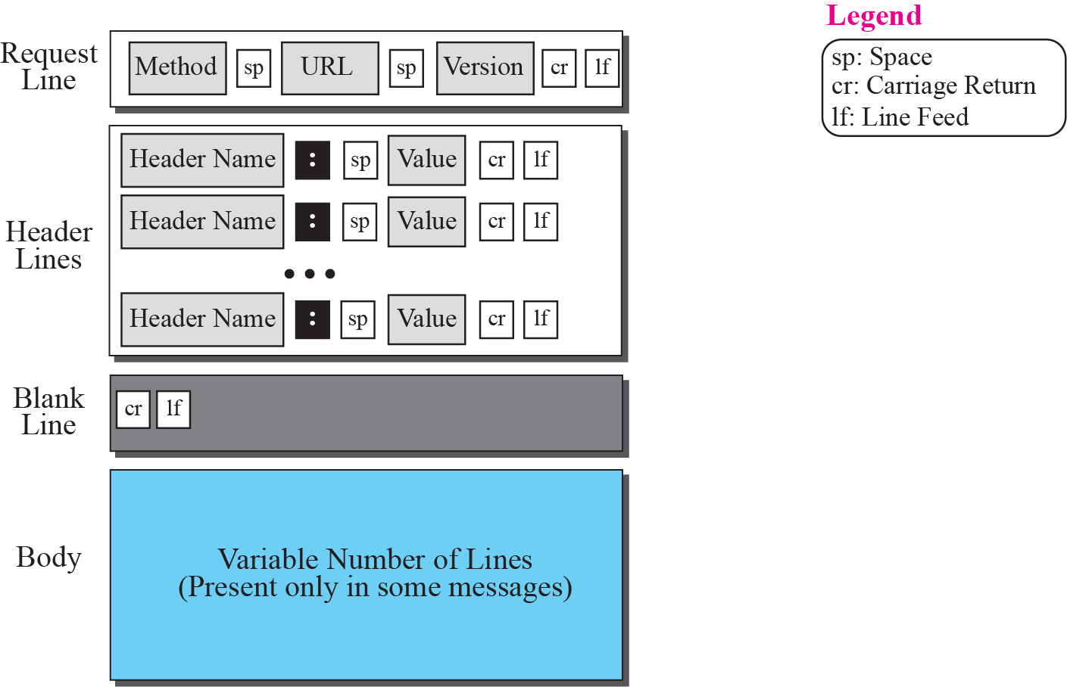
Figure 22.11 Format of the request message
TCP/IP Protocol Suite

Slide 26
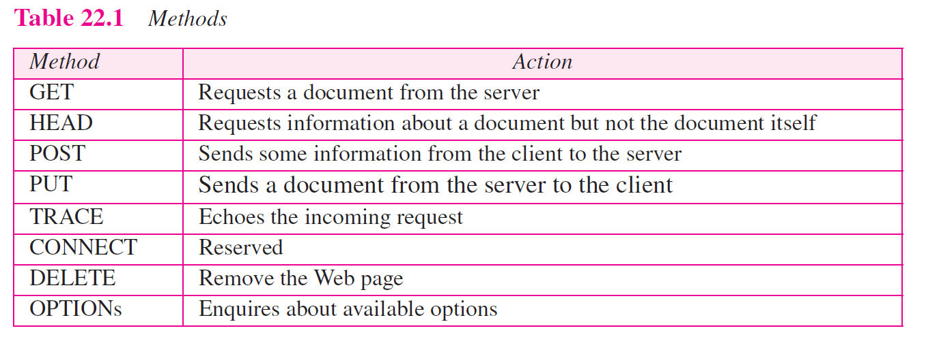
TCP/IP Protocol Suite

Slide 27
Header Lines In Request Message
Can have zero or more request header lines.
Each header line sends additional information from the client to the server.
Example : The client can request that the document be sent in a special format.
Each header line has a header name, a colon, a space, and a header value.
Body In Request Message
The body can be present in a request message.
Usually, it contains the comment to be sent.
TCP/IP Protocol Suite

Slide 28
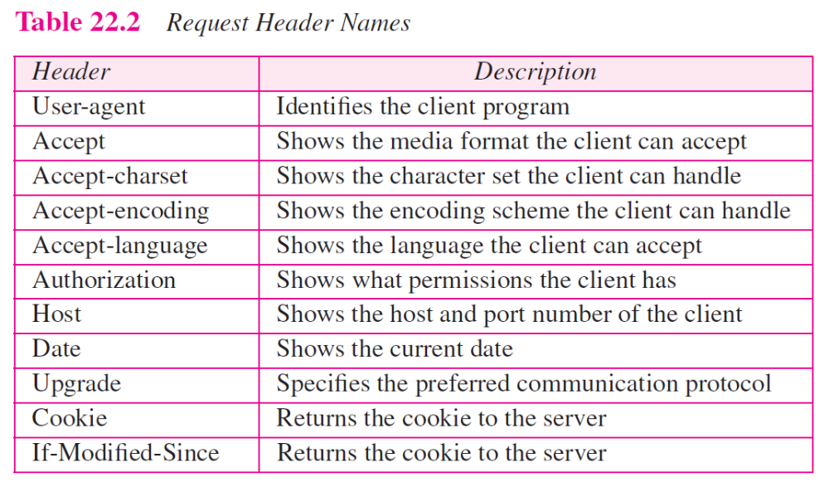
TCP/IP Protocol Suite

Slide 29

Figure 22.12 Format of the response message
Response Message
consists of a status line, header lines, a blank line and sometimes a body.
Status Line
Contains 3 fields: version, status code and Phrase
TCP/IP Protocol Suite

Slide 30
Figure 22.12 Format of the response message
The first field defines the version of HTTP protocol, currently 1.1.
The status code field defines the status of the request.
It consists of three digits.
The codes in the 100 range are only informational
The codes in the 200 range indicate a successful request.
The codes in the 300 range redirect the client to another URL
The codes in the 400 range indicate an error at the client site.
The codes in the 500 range indicate an error at the server site.
The status phrase explains the status code in text form.
TCP/IP Protocol Suite

Slide 31
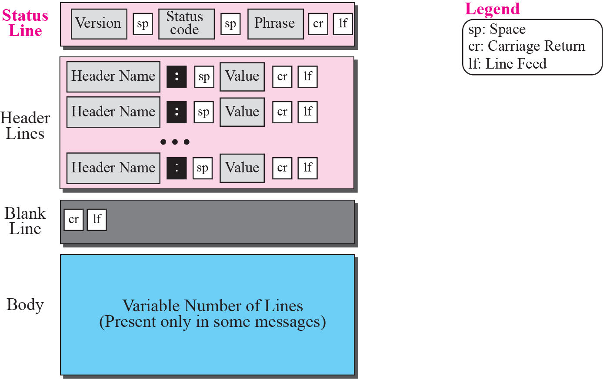
Figure 22.12 Format of the response message
TCP/IP Protocol Suite

Slide 32
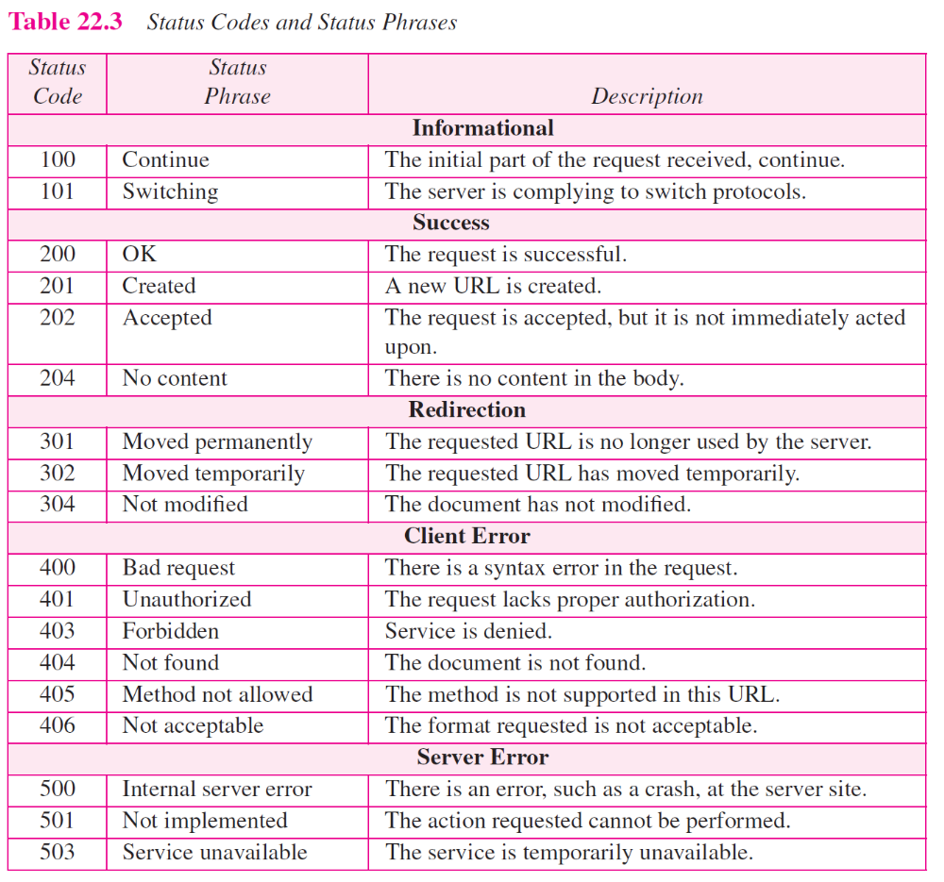
TCP/IP Protocol Suite

Slide 33
Header Lines In Response Message
Can have zero or more response header lines.
Each header line sends additional information from the server to the client.
Body
The body contains the document to be sent from the server to the client.
The body is present unless the response is an error message.
TCP/IP Protocol Suite

Slide 34
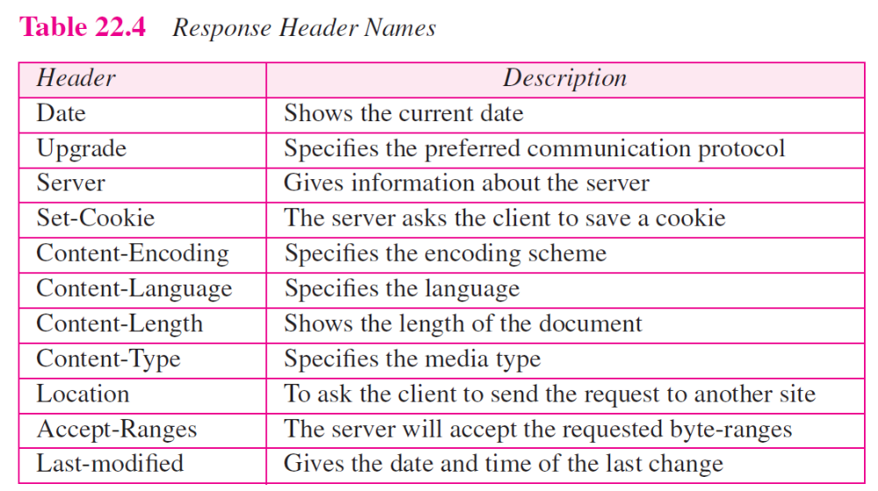
TCP/IP Protocol Suite

Slide 35
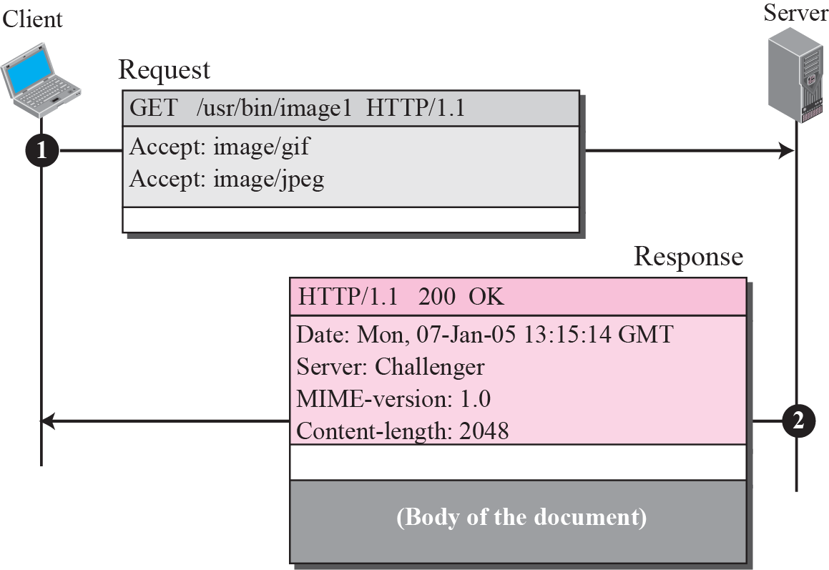
Figure 22.13 Example 22.4
GET method to retrieve an image with the path /usr/bin/image1.
Header has two lines that show that the client can accept images in the GIF or JPEG format.
Response Header lines define the date, server, MIME version, and length of the document.
TCP/IP Protocol Suite

Slide 36
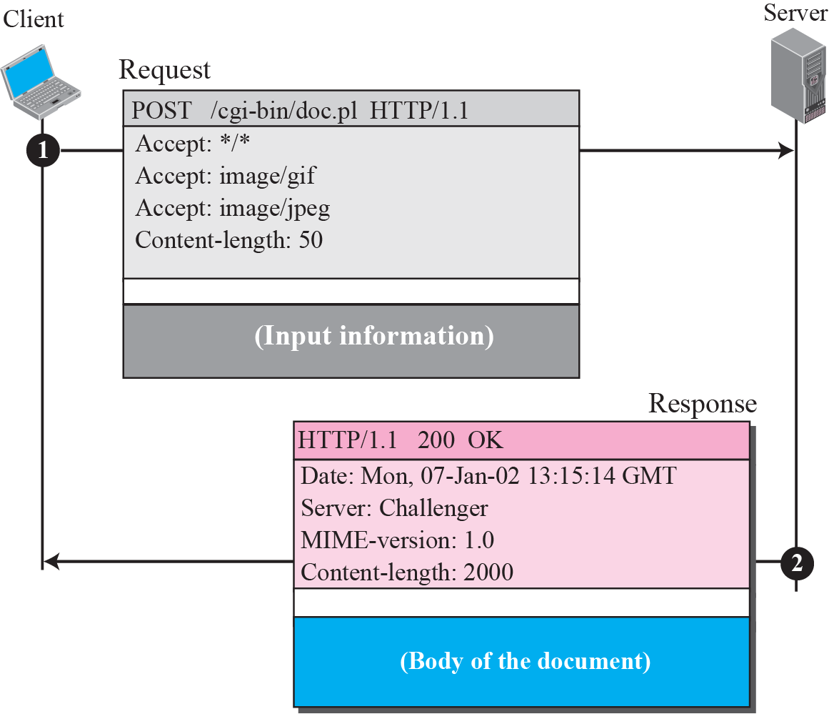
Figure 22.14 Example 22.5
Here the client wants to send data to the server.
The request line shows the method (POST), URL, and HTTP version (1.1).
The request body contains the input information.
The created document, is included as the body.
TCP/IP Protocol Suite

Slide 37
Conditional Request
A client can add a condition in its request.
In this case, the server will send the requested Web page if the condition is met or inform the client otherwise.
One of the most common conditions imposed by the client is the time and date the Web page is modified.
Client can send the header line If-Modified-Since to the request to tell the server that it needs the page if it is modified after a certain point of time.
TCP/IP Protocol Suite

Slide 38
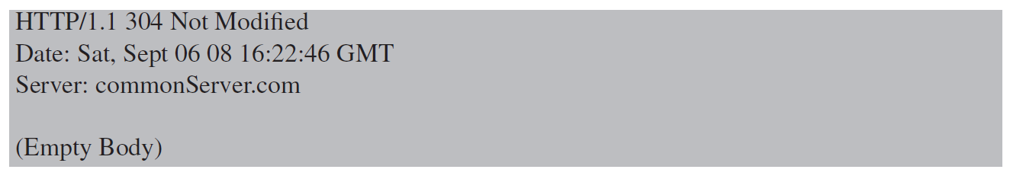
Example 22.7
Client imposes the modification data and time condition on a request.
Status line in the responds shows the file is not modified after the defined point of time. The body of the response message is also empty.
TCP/IP Protocol Suite

Slide 39
Persistence
HTTP, prior to version 1.1, specified a nonpersistent connection, while a persistent connection is the default in version 1.1.
Nonpersistent Connection
In nonpersistent connection, one TCP connection is made for each request/response.
The following lists the steps in this strategy:
1. Client opens a TCP connection and sends a request.
2. Server sends the response and closes the connection.
3. Client reads the data until it encounters an end-of-file marker; it then closes theconnection.
In this strategy, if a file contains link to N different pictures in different files (all located on the same server), the connection must be opened and closed N + 1 times.
Nonpersistent strategy imposes high overhead on the server because the server needs N + 1 different buffers and requires a slow start procedure each time a connection is opened.
TCP/IP Protocol Suite

Slide 40
Example 22.8
Figure 22.15 shows an example of a nonpersistent connection.
The client needs to access a file that contains two links to images.
The text file and images are located on the same server.
TCP/IP Protocol Suite

Slide 41
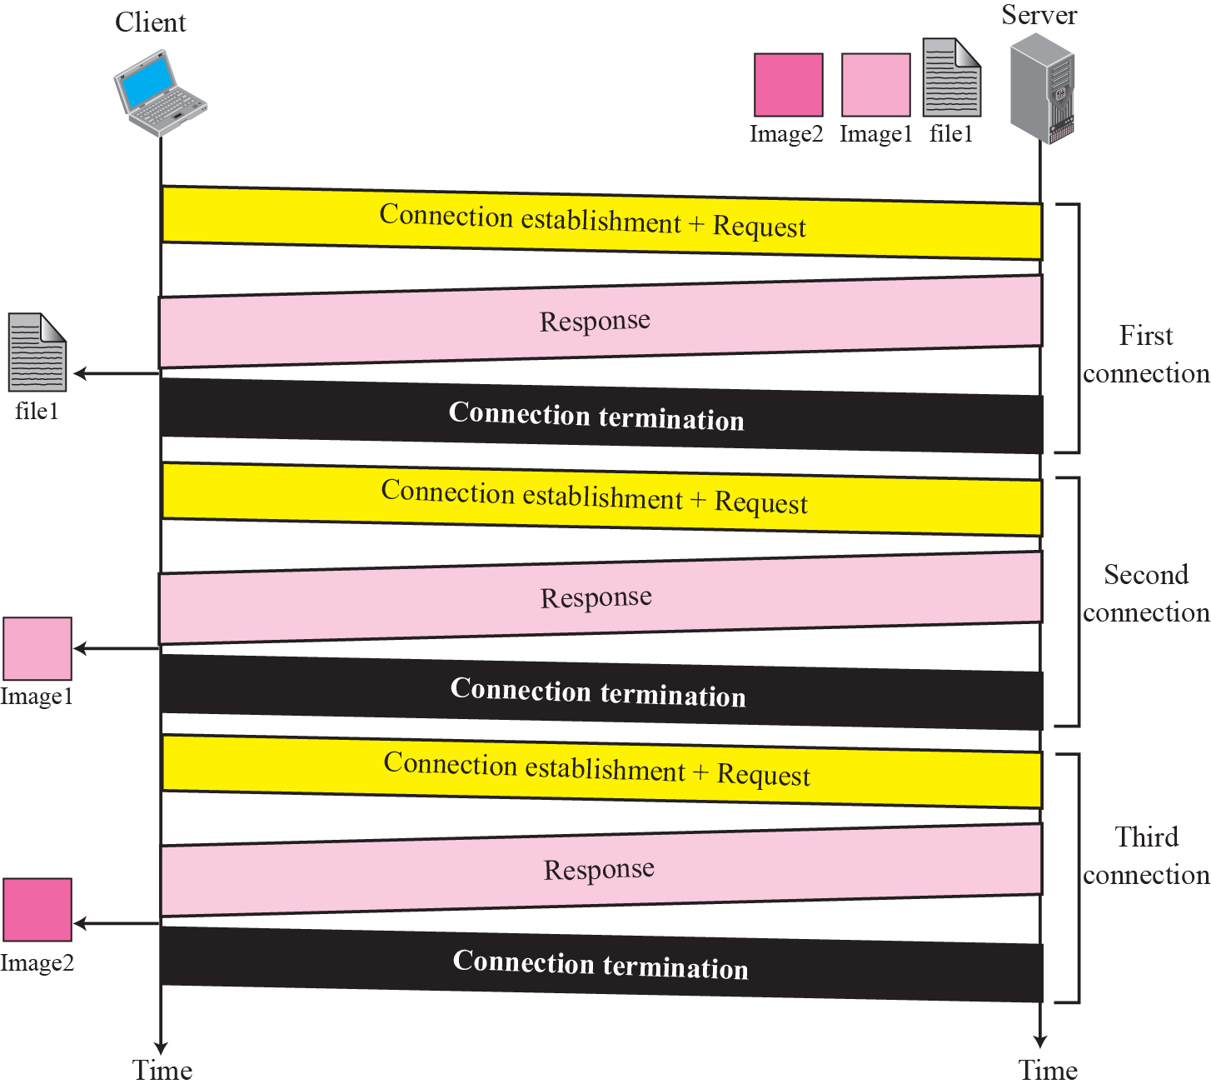
Figure 22.15 Example 22.8
TCP/IP Protocol Suite

Slide 42
Persistent Connection
HTTP version 1.1 specifies a persistent connection by default.
In a persistent connection, the server leaves the connection open for more requests after sending a response.
The server can close the connection at the request of a client or if a time-out has been reached.
TCP/IP Protocol Suite

Slide 43
HTTP version 1.1 specifies a persistent connection by default.
TCP/IP Protocol Suite

Slide 44
Example 22.9
Figure 22.16 shows the same scenario as Example 22.8, but using persistent connection.
TCP/IP Protocol Suite

Slide 45
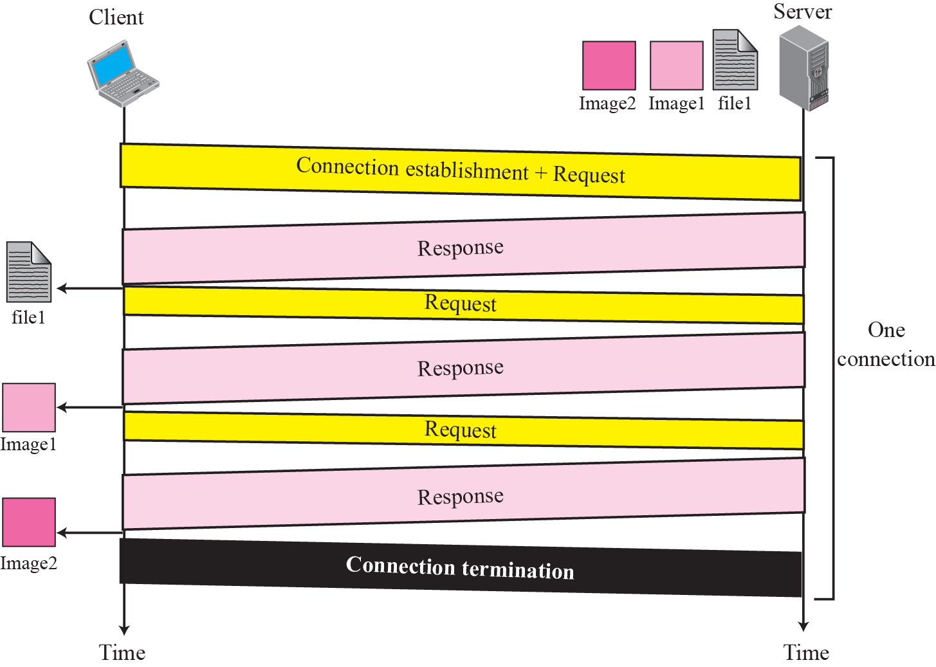
Figure 22.16 Example 22.9
TCP/IP Protocol Suite

Slide 46
Cookies
The World Wide Web was originally designed as a stateless entity.
A client sends a request; a server responds. Their relationship is over.
Today the Web has other functions; some are listed below:
Websites are being used as electronic stores that allow users to browse through the store, select wanted items, put them in an electronic cart, and pay at the end.
Some websites need to allow access to registered clients only.
For these purposes, the cookie mechanism was devised.
TCP/IP Protocol Suite

Slide 47
Creating and Storing Cookies
The creation and storing of cookies depend on the implementation; however, the principle is the same.
When a server receives a request from a client, it stores information about the client in a file or a string. The information may include the domain name of the client, the contents of the cookie (information the server has gathered about the client such as name, registration number, and so on), a timestamp, and other information depending on the implementation.
The server includes the cookie in the response that it sends to the client.
When the client receives the response, the browser stores the cookie in the cookie directory.
TCP/IP Protocol Suite

Slide 48
Using Cookies
When a client sends a request to a server, the browser looks in the cookie directory to see if it can find a cookie sent by that server. If found, the cookie is included in the request. When the server receives the request, it knows that this is an old client, not a new one.
❑ An electronic store (e-commerce) can use a cookie for its client shoppers. When a client selects an item and inserts it into a cart, a cookie that contains information about the item, such as its number and unit price, is sent to the browser. If the client selects a second item, the cookie is updated with the new selection information. And so on. When the client finishes shopping and wants to check out, the last cookie is retrieved and the total charge is calculated.
❑ The site that restricts access to registered clients only sends a cookie to the client when the client registers for the first time. For any repeated access, only those clients that send the appropriate cookie are allowed.
TCP/IP Protocol Suite

Slide 49
Example 22.10
Figure 22.17 shows a scenario in which an electronic store can benefit from the use of cookies.
Assume a shopper wants to buy a toy from an electronic store named BestToys.
The shopper browser (client) sends a request to the BestToys server.
TCP/IP Protocol Suite

Slide 50
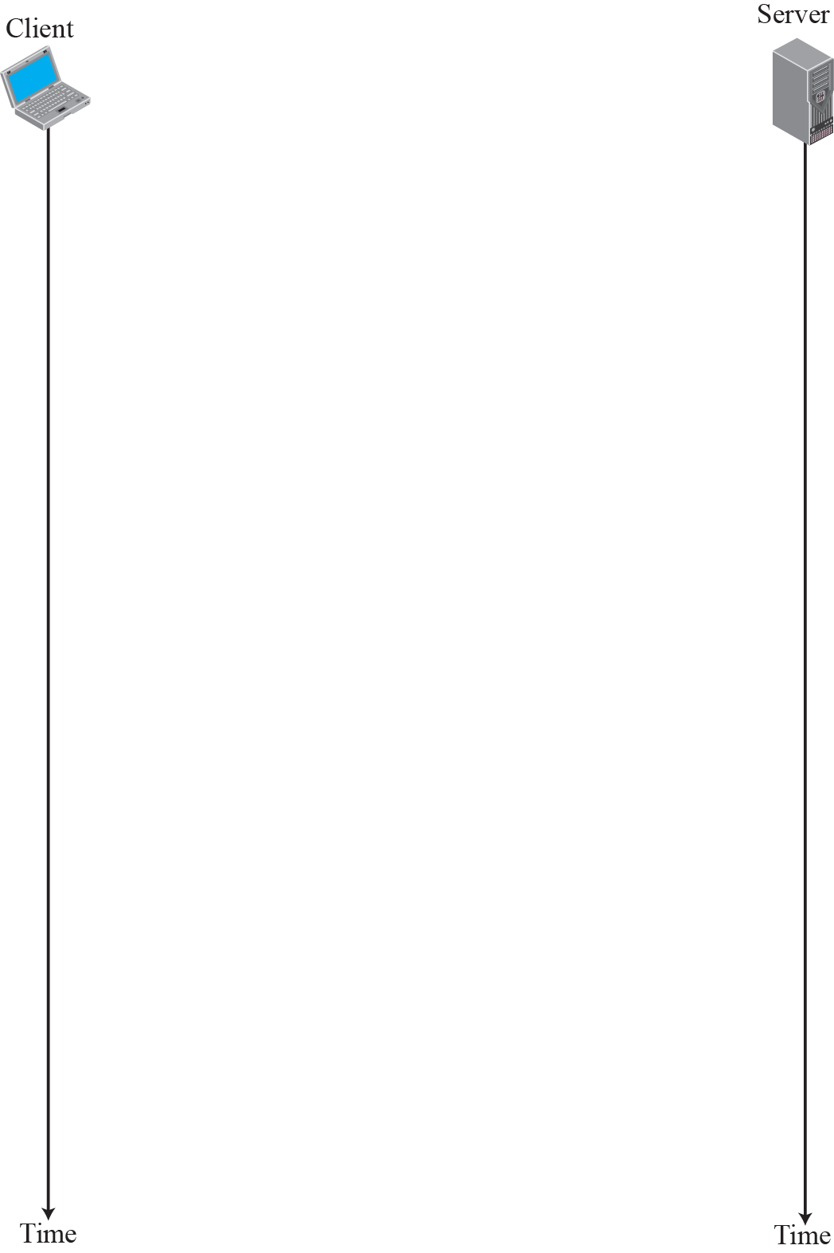
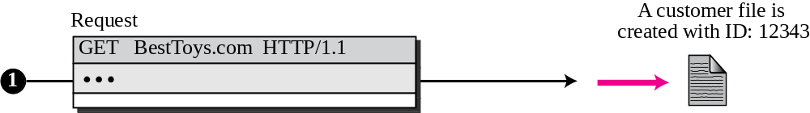

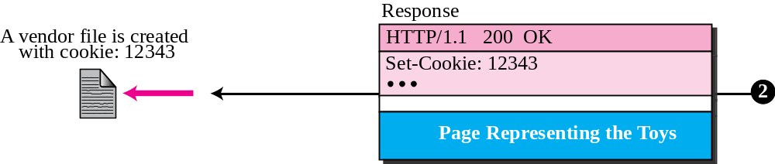
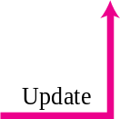

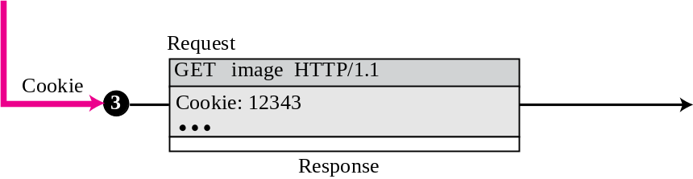
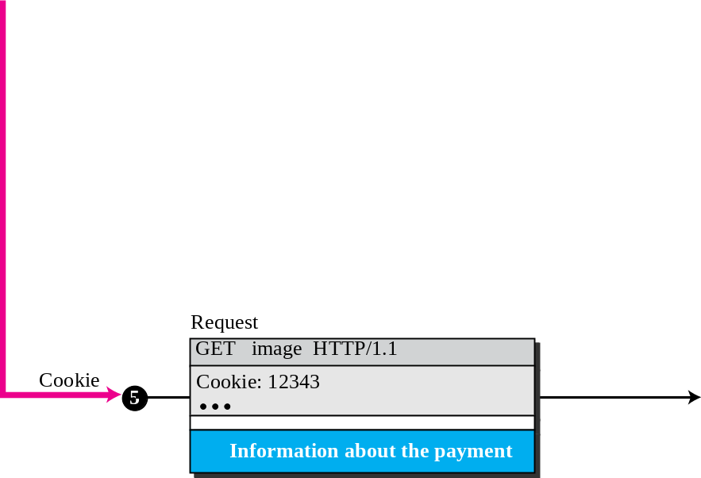
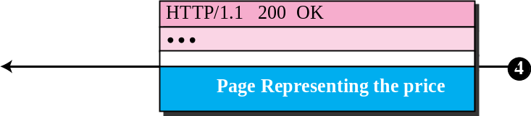
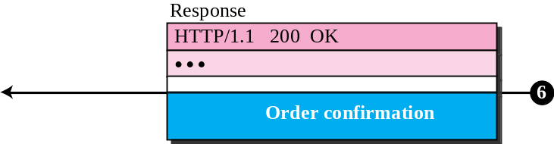
Figure 22.17 Example 22.10
TCP/IP Protocol Suite

Slide 51
END
TCP/IP Protocol Suite

